Slide 1
Energy
19/03/2018
Marie Niclas, Amélie Bois ISARA 2018

Slide 2
Plan
Introduction
5. Conclusion
2. Fossil fuels
4. Renewable energies
3. Nuclear energy

Slide 3

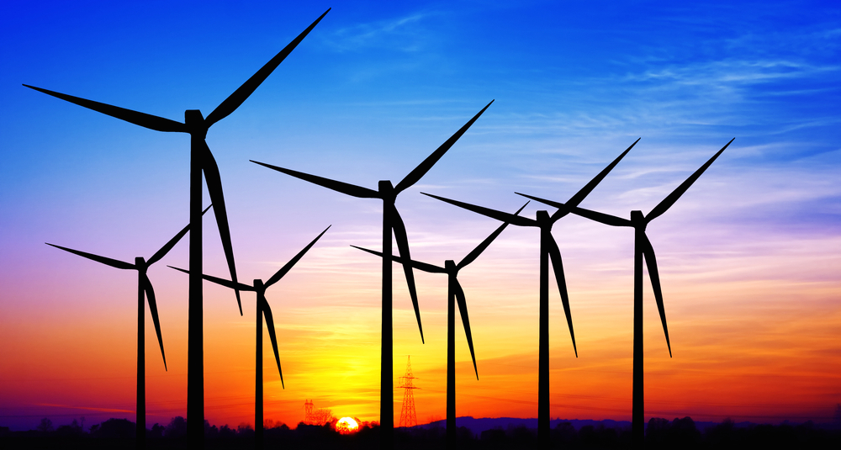
Introduction
Energy:
Strength and vitality required for physical or mental activities
Power derived from the utilization of physical or chemical resources (Oxford dictionaries)
Types of energies:
Non-renewable energy: does not restock in a short period of time
Renewable energy
Uses of energy:
Transport, electricity, heat…
Figure: Man running producing energy (Cocktail of health)
Figure: Energy from the wind (Brighten Solar)

Slide 4
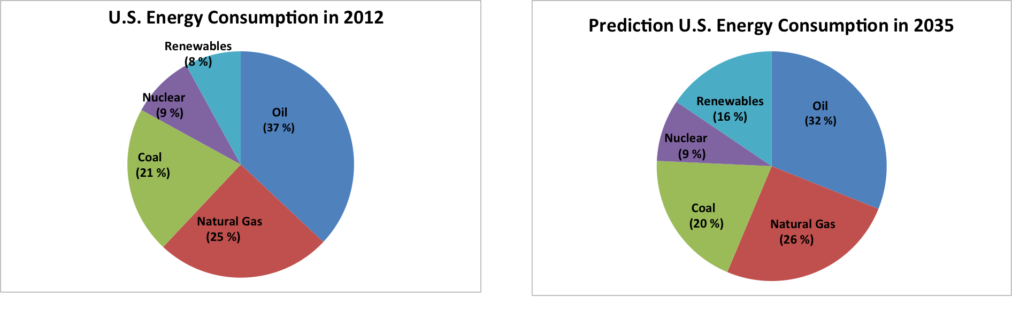
Figure: Pie chart
Notes:
For you to have a global vision of the energy consumption; here is a pie chart representing the US energy consumption in 2012. More than 70% of the US energy consumption is based on Fossil energies (coal, natural gas, oil), only 8 % of the energy consumption is based on Renewables energies and almost 10% based on the nuclear energy. Fossil fuels are an important source of energy today.

Slide 5

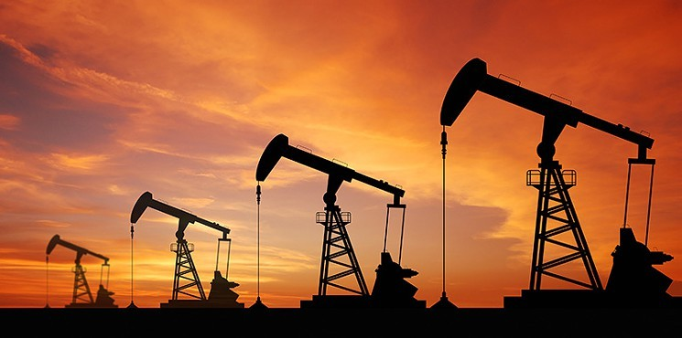
2. Fossil fuels
A. Definition
All fossil fuels are non-renewable, but not all non-renewable energies sources are fossil fuels.
Non-renewable energies:
Crude oil → Fossil fuel
Natural Gas → Fossil fuel
Coal → Fossil fuel
Uranium
Fossil fuel: comes from plants and animals that lived millions of years ago
Figure: Drilling of oil wells (Houstonpress)

Slide 6
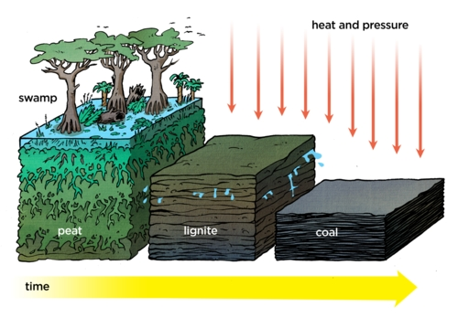
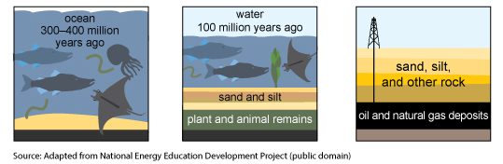
2. Fossil fuels
B. Oil, Natural Gas and coal formation
Step 1: Death and burial of marine plants and animals on the ocean floor (oil and natural gas) or dinosaurs and plants in swampy forest (coal)
Step 2: Remain transformation into oil and natural gas
Step 3: Drill through soil layers to reach the rock formation containing oil and natural gas
Figure: Oil and Natural Gas formation (U.S Energy Information)
Figure: Coal formation (Knuttz)

Slide 7
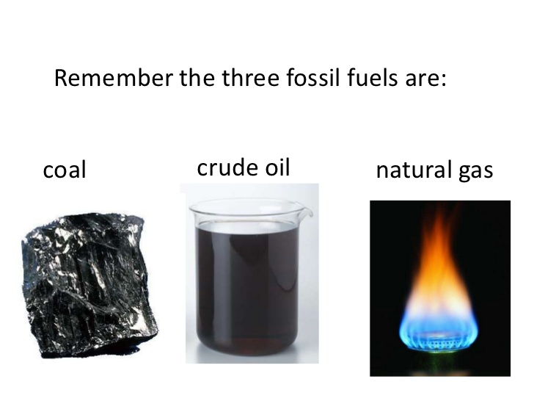
2. Fossil fuels
B. Oil, Natural Gas and coal characteristics
Crude oil | Natural gas | Coal
Mixture of hydrocarbons Sedimentary rocks Liquid form | Methane, hydrocarbon and non-hydrocarbon gas Special types of rocks | High amount of carbons and hydrocarbons
Figures: Crude oil, natural gaz and coal’ form (Tes)
Petroleum products: fuels made from crude oil and other hydrocarbons contained in natural gas

Slide 8
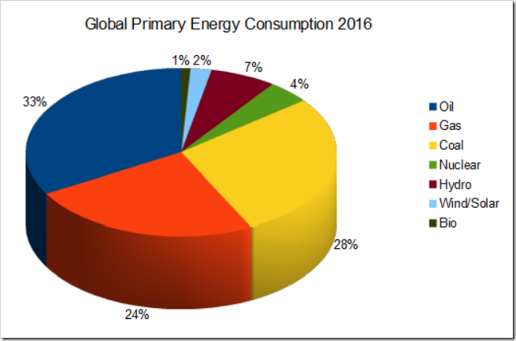
2. Fossil fuels
C. Distribution of the energy consumption in the world
Figure :Pie chart(Climate Depot)

Slide 9
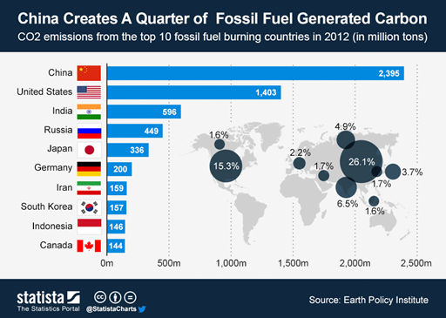
2. Fossil fuels
D. The most important consumer of fossil fuel in the world
Figure: Bar chart and map describing the amount of carbon generated by country because of fossil fuel consumption. (Statista)

Slide 10
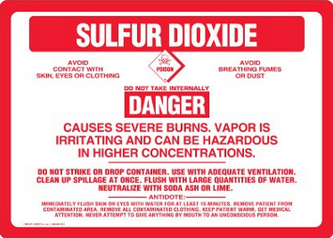
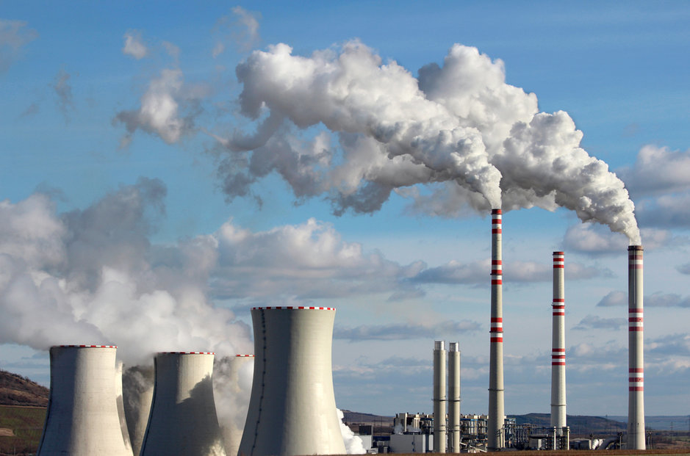
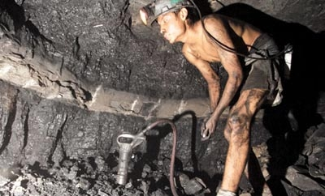
2. Fossil fuels
E. Advantages & Drawbacks
Figure: Warning picture about sulphur dioxide (Worldpress)
Advantages Drawbacks
Stations in any location
Generation of a huge amount of electricity in a single place
Main cause of Greenhouse effect, Global Warming
Production of sulphur dioxide engendering acid rains
Coal mining: one of the most dangerous work
Figure: Man in a coal mine (Alamy)
Figure : Fossil fuel Station ( Government technology)

Slide 11
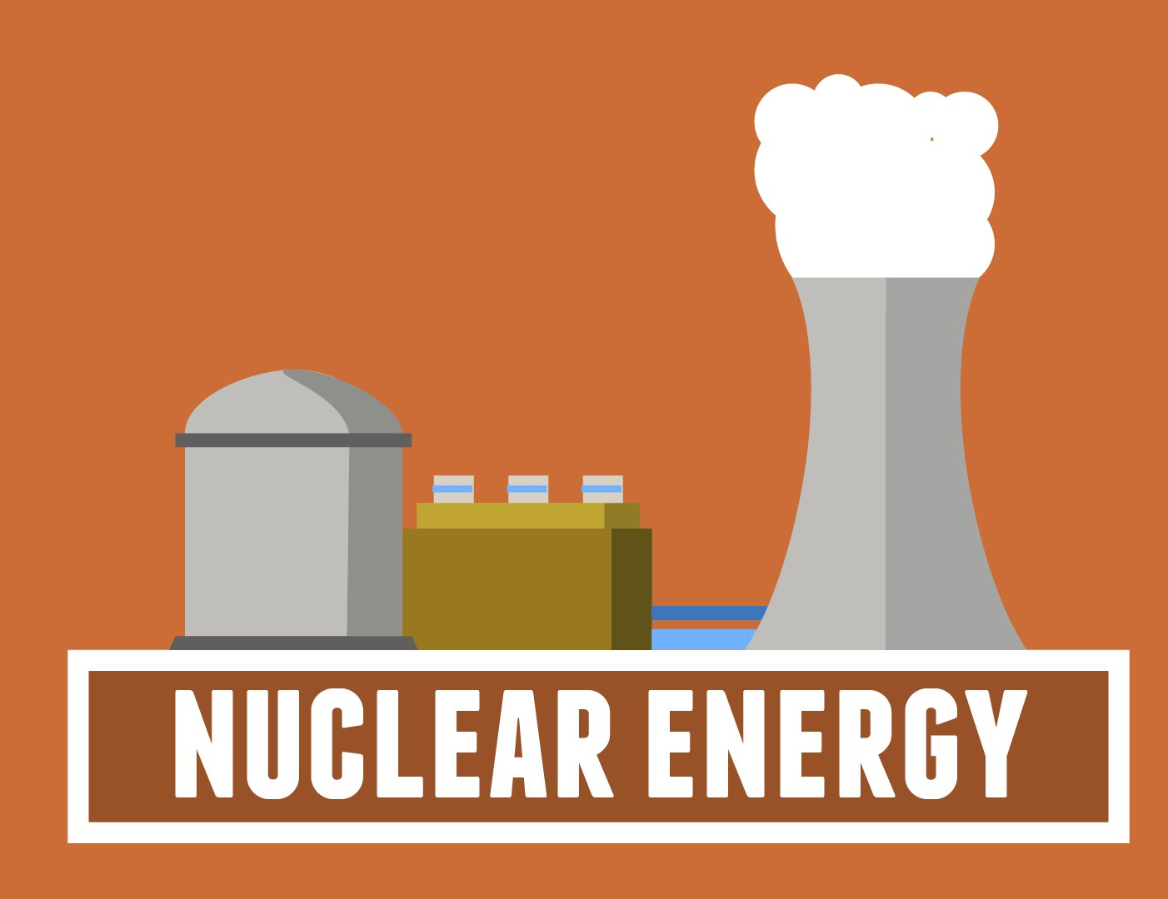
3. The nuclear energy
A. Definition
Energy coming from the nucleus of the atom.
Figure: nuclear power plant

Slide 12
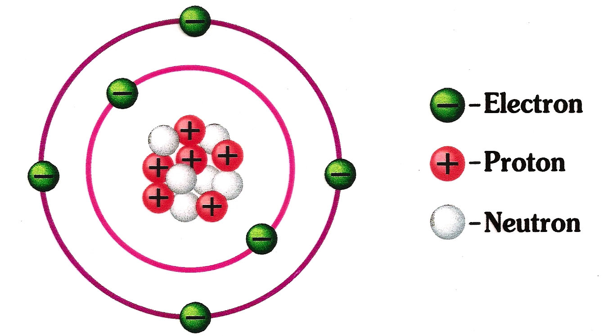
Figure: Representation of an atom

Slide 13

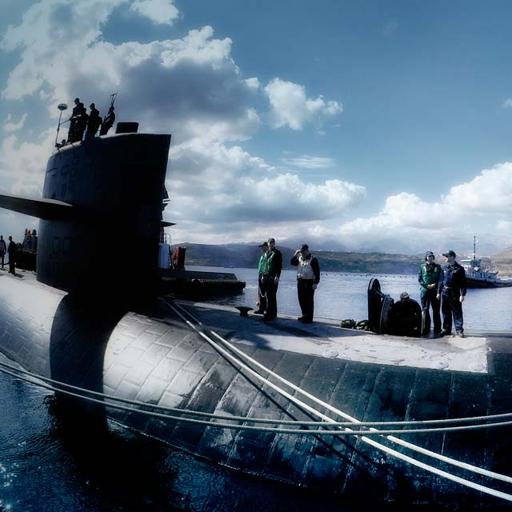
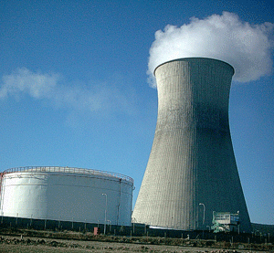
2. The nuclear energy
B. History...
E=MC² Einstein 1905
1930s and ’40s Discovery of this Energy
End of World War II Nuclear navy…
Today 400 reactors
Figure: Albert Einstein
Figure: Nuclear Navy
Figure: Nuclear reactor

Slide 14
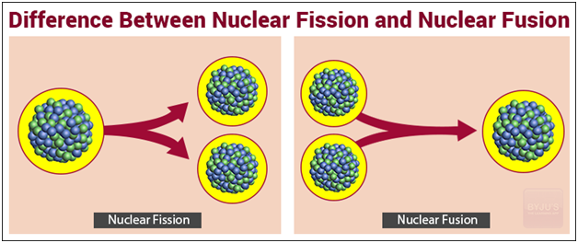
2. The nuclear energy
C. Nuclear fission and Nuclear Fusion
Figure: Illustration showing the difference between Fission and Fusion
Notes:
Fission is the energetic splitting of large atoms such as Uranium or Plutonium into two smaller atoms, called fission products. To split an atom, you have to hit it with a neutron. Several neutrons are also released which can go on to split other nearby atoms, producing a nuclear chain reaction of sustained energy release.
Fusion is the combining of two small atoms such as Hydrogen or Helium to produce heavier atoms and energy. These reactions can release more energy than fission without producing as many radioactive byproducts.This reaction has not been commercially developed yet and is a serious research interest worldwide, due to its promise of nearly limitless, low-pollution, and non-proliferative energy.

Slide 15
2. The nuclear energy
D. Advantages & Drawbacks
Advantages | Drawbacks
 | Raw materials
Price of the raw materials | Water pollution and wastes
Reliable | Shutdown reactors
Greenhouse gas | Leaks
 | Dramatic accidents
Notes:
Raw materials:Uranium is used in the process of fission because it's a naturally unstable element. This means that special precautions must be taken during the mining, transporting and storing of the uranium
Water polluants: Nuclear fission chambers are cooled by water, in both the boiling water reactors (BWRs) and pressurized water reactors (PWRs). In BWRs, water runs through the reactor core, so if there is any leakage of fuel, the water can get contaminated and is transported to the rest of system.
Other pollutants released by nuclear plants are heavy metals and toxic pollutants
When the uranium has finished splitting, the resulting radioactive byproducts need to be removed. While recycling efforts of this waste product have been undertaken in recent years, the storage of the by-product could lead to contamination through leaks or containment failures.
Leaks: Nuclear reactors are built with several safety systems designed to contain the radiation given off in the fission process. When these safety systems are properly installed and maintained, they function adequately. When they are not maintained, have structural flaws or were improperly installed, a nuclear reactor could release harmful amounts of radiation into the environment during the process of regular use. If a containment field were to rupture suddenly, the resulting leak of radiation could be catastrophic.

Slide 16
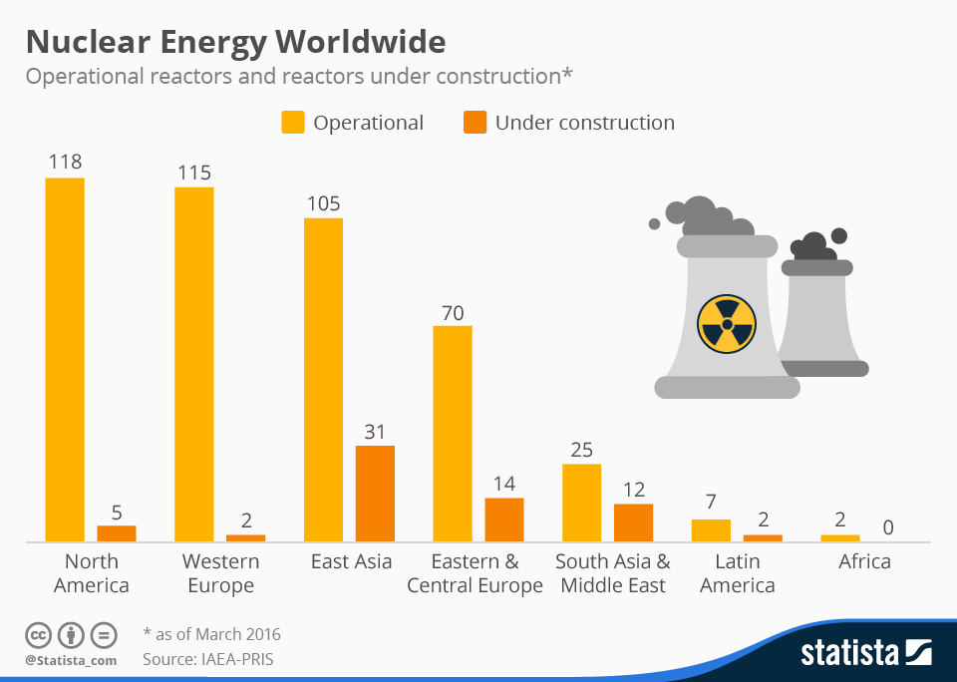
2. The nuclear energy
E. World distribution
Figure: Bar chart of the nuclear energy worldwide
Notes:
To finish, this bar chart represents the number of operational reactors and reactors under construction in different parts of the world. Orange: Reactors under construction, Yellow: operational reactors. In North America, 118 reactors are operational whereas in Africa only 2 are operationals. Moreover, we can see that the parts that have the higher number of operational reactors are; North America, Western Europe, East Asia and Eastern and Central Europe. We can see that Asia is the part of the world which build the highest number of reactors. Globally, developing countries are looking to increase their number of nuclear reactors. Furthermore, the developed parts of the world don’t really continue to build reactors because they have already many of it.

Slide 17


4. Renewable energies
Energies that are inexhaustible and which are coming from natural elements
Figure: green bulb
Figure: Green electric wire

Slide 18

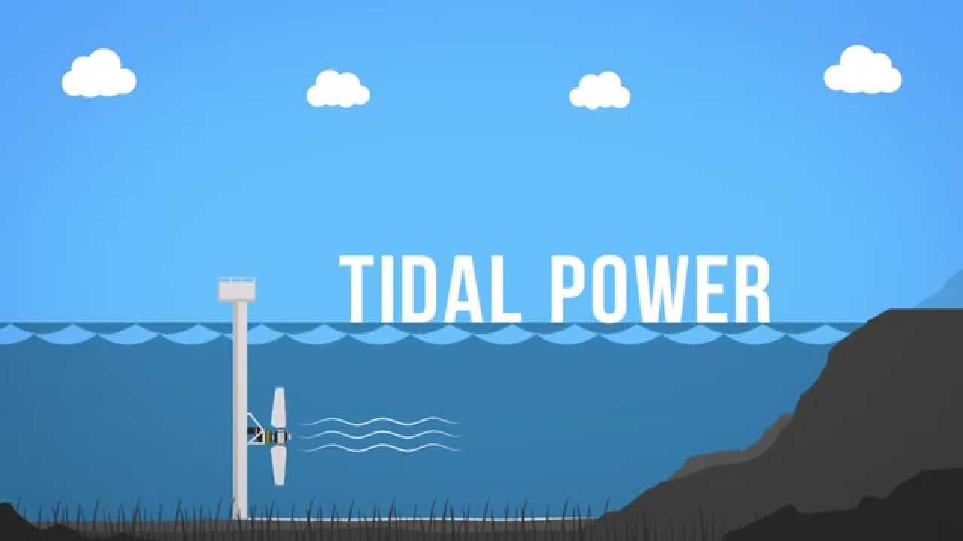

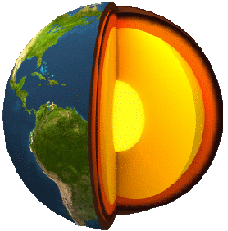

Figure: The Sun
Types of
renewable energies
Figure: Tidal installation
Figure: Wind with leaves
Figure: The surface and the core of the earth
Figure: Sources of biomass

Slide 19

2. Renewable energies
A. Biomass energy
« Biomass energy refers to the use of organic materials and converting them into other forms of energy that can be used »
Advantages Drawbacks
carbon neutral - increase methane gases
widely available - risk of deforestation
cheap - needs a lot of water
waste - not as efficient as fossil energies
Figure: Green earth

Slide 20




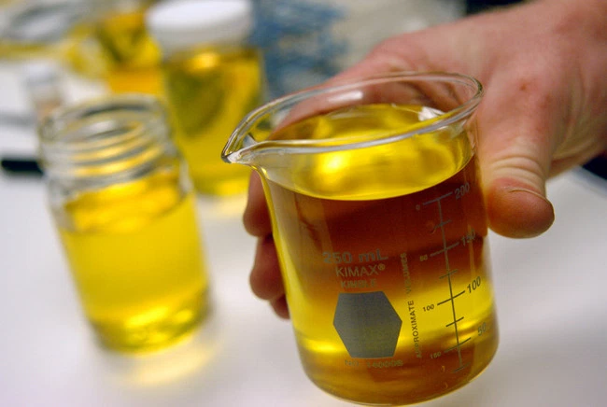
Figure: Biodiesel
Figure: Biofuel
Figure: erlenmeyer flask of biodiesel
Figure: Biodiesel on the earth
Figure: beaker of biofuel

Slide 21

2. Renewable energies
B. Solar energy
« Solar power is an energy from the sun that is converted into thermal or electrical energy »
Advantages Drawbacks - weather dependent
reduces electricity bill - uses a lot of space
diverse applications - expensive initially
low maintenance costs - solar energy storage is expensive
Efficient - stop fire
- pollution
Figure: The sun supplying a solar panel

Slide 22
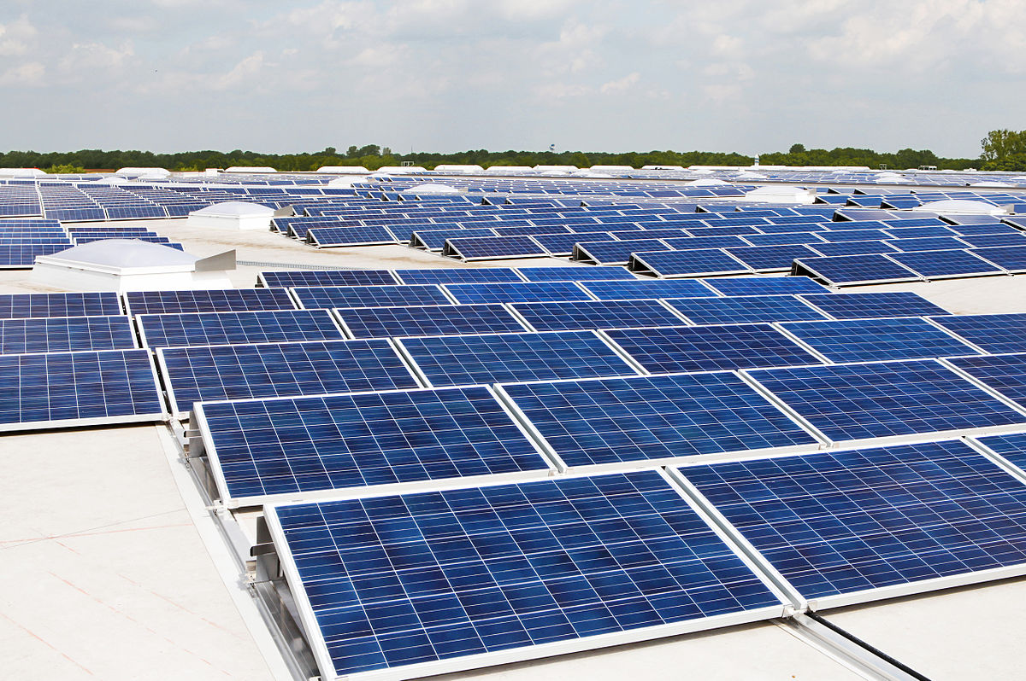
Figure: Huge solar panel facility

Slide 23

2. Renewable energies
C. Wind power
« Power derived from wind: used to generate electricity or mechanical power. »
Advantages Drawbacks
- natural - weather dependent
efficient - visual pollution
no greenhouse gas after - noisy built - built is polluting
doesn’t takes a lot of space
Figure: Landscape with a wind turbine

Slide 24
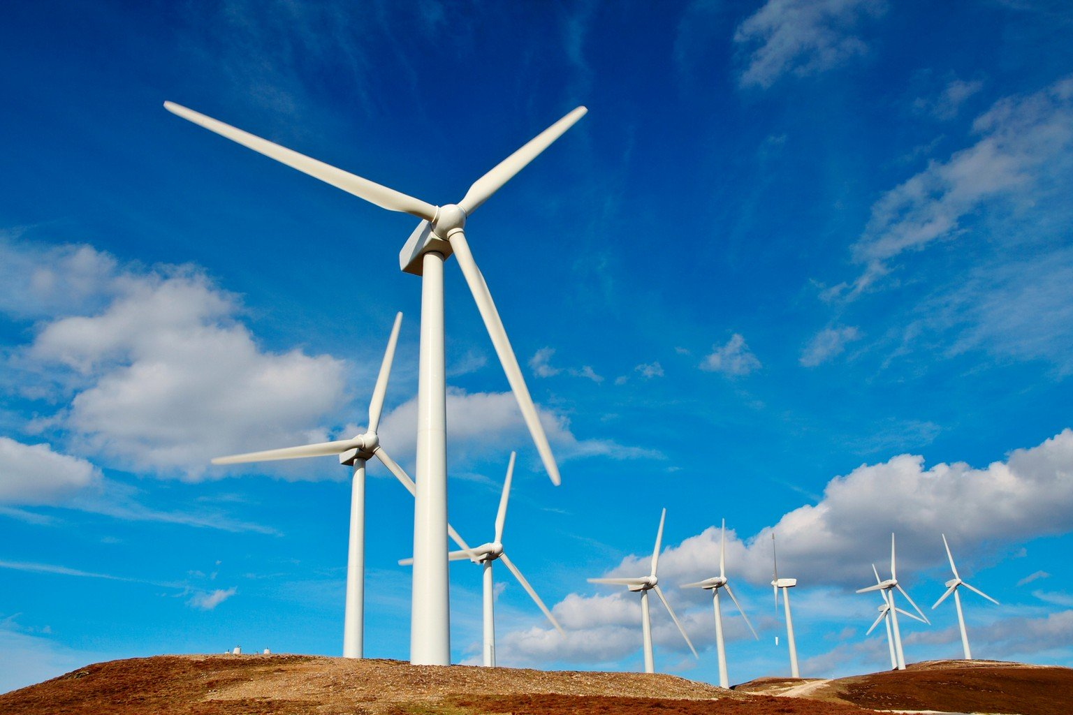
Figure: Landscape with numerous wind turbines

Slide 25
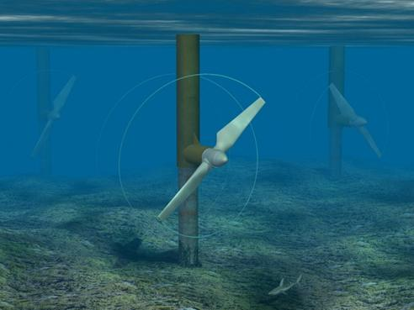
2. Renewable energies
D. Tidal power
« The use of the rise and fall of tides involving very large volumes of water at low heads to generate electric power. »
Advantages Drawbacks
predictable - bad effect on environment and biodiversity
effective at low speed - expensive
long lived - few ideal location
costs of maintenance are - need more technological breakthrough low
Figure: Tidal power facility

Slide 26
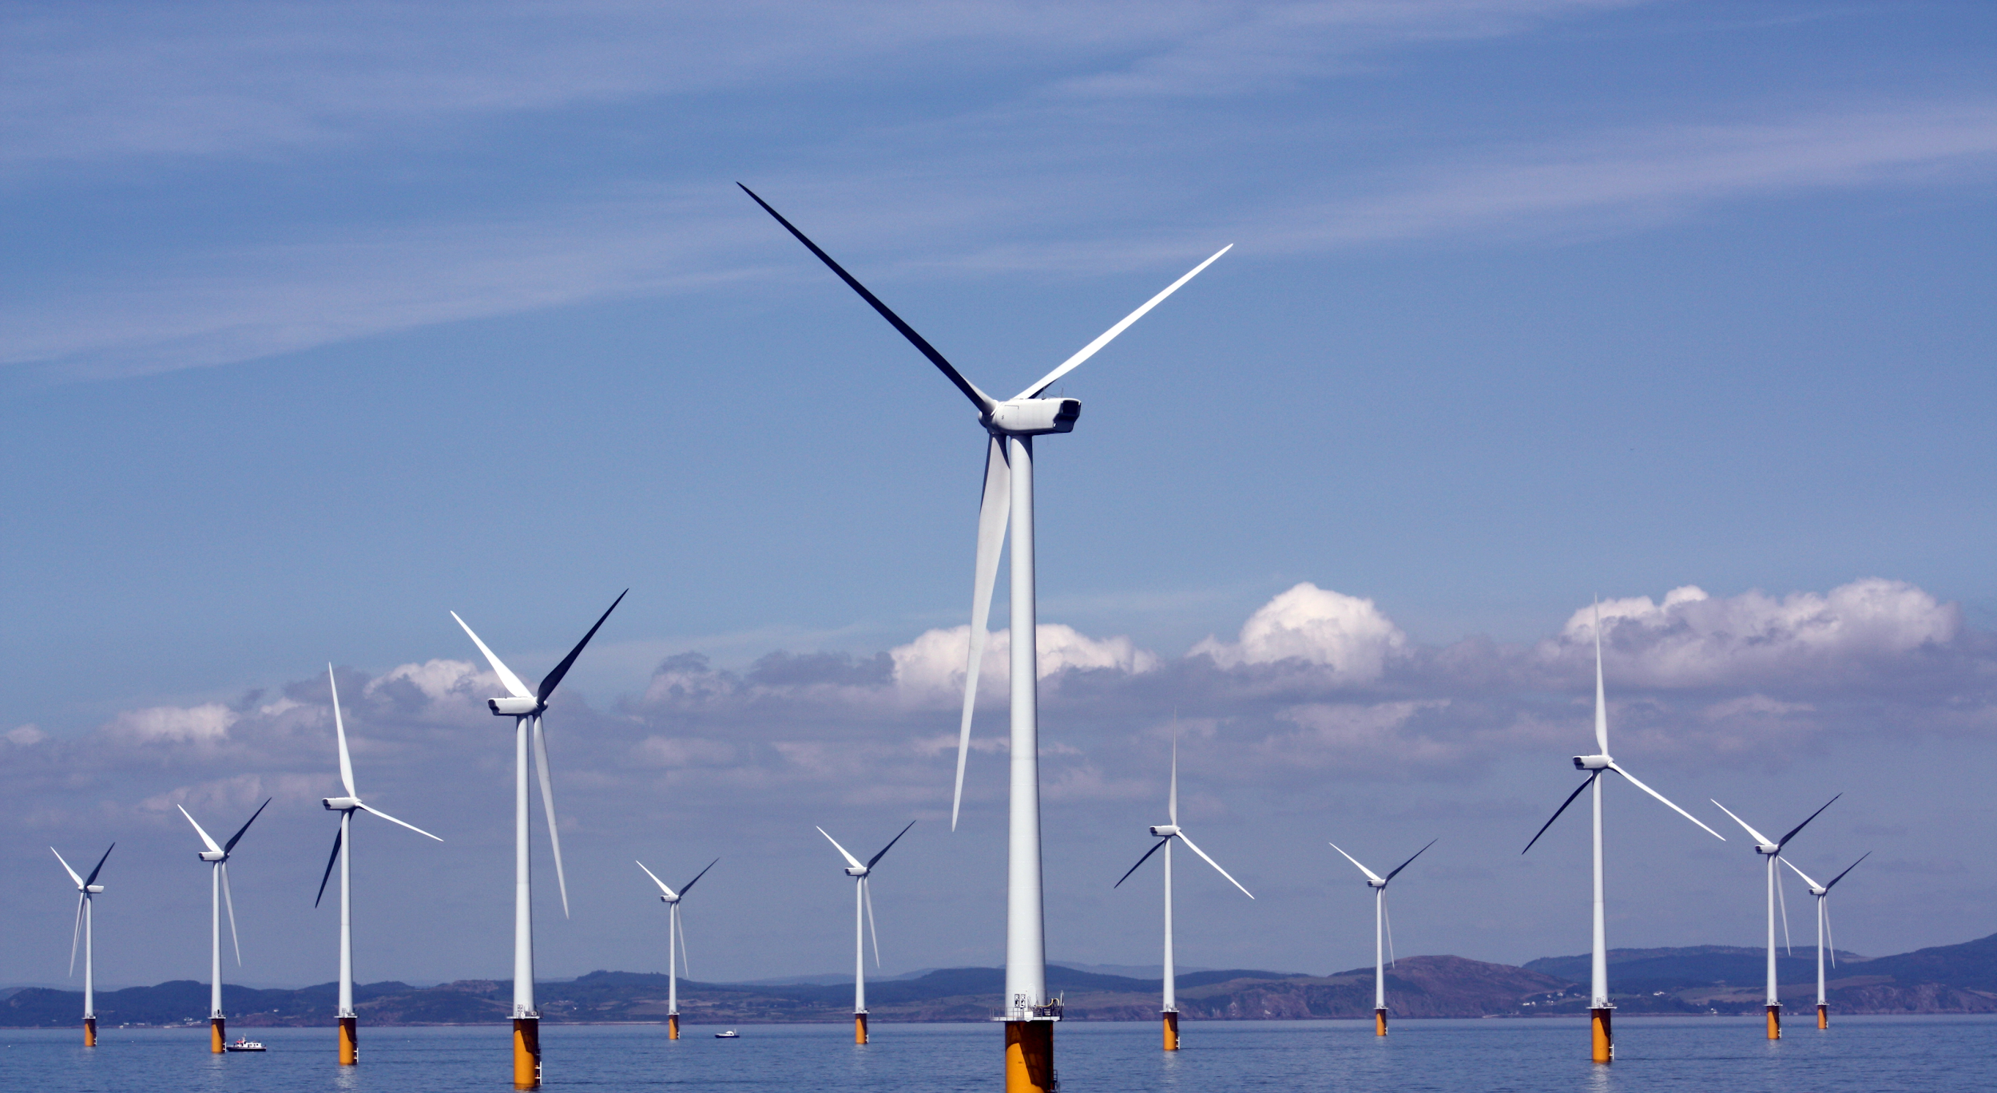
Figure: Numerous tidal energy facilities

Slide 27
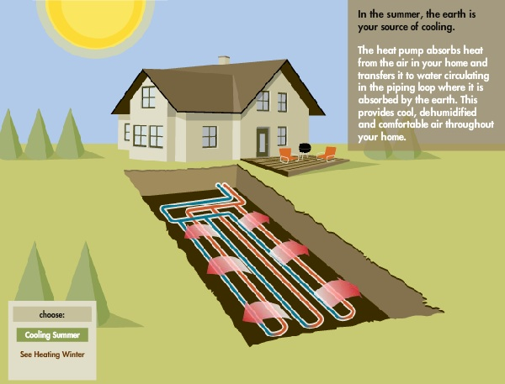
2. Renewable energies
E. Geothermal energy
« Energy obtained by tapping underground tanks of heat, usually near volcanoes or other hot spots on the surface of the Earth. »
Advantages Drawbacks
reliable - release greenhouse gas
efficient - possibility of depletion
little or no needs of - high investment cost maintenance - land require
Figure: Geothermal mechanism at home
Notes:
In this case this energy is derived from the earth, usually from magma conduits hot springs or hydrothermal circulation to spin turbins or heat buildings.
Renewable energy have its advantages and drawbacks but they are more sustainable and respectful of the environment so it is a field to develop.

Slide 28
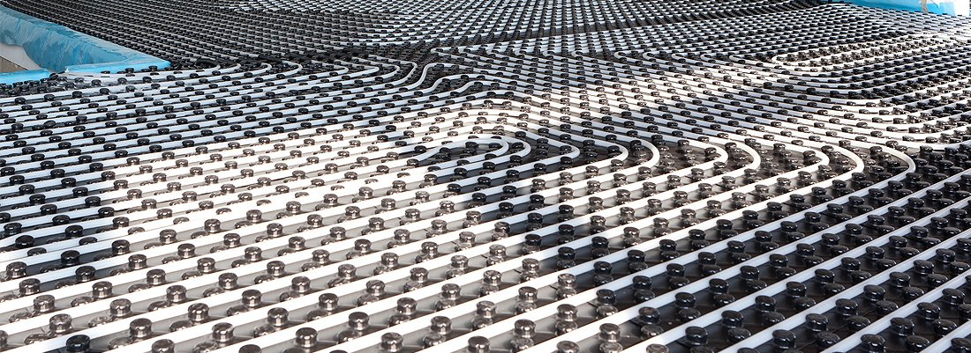
Figure: Geothermal pipes

Slide 29
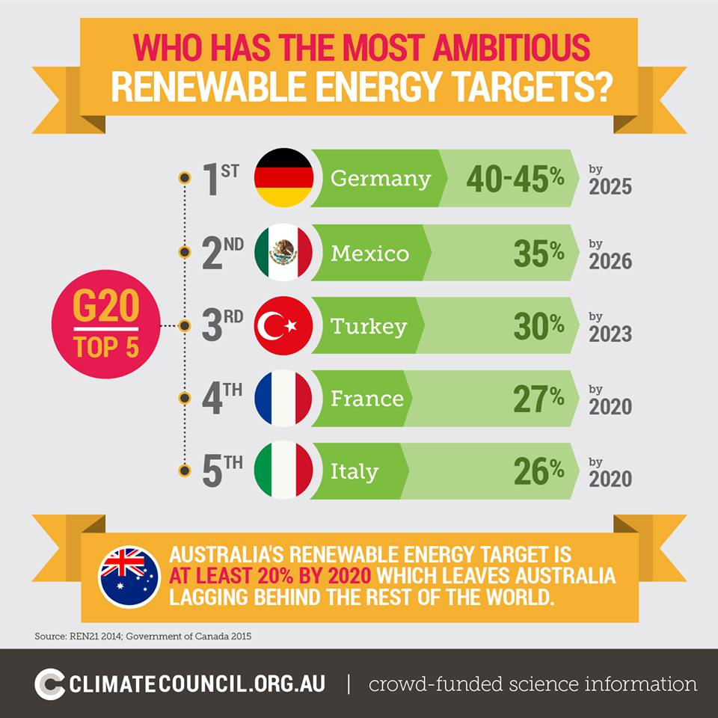
2. The renewable energies
F. World distribution
G20:
The G-20's members represent two-thirds of the world's people and 85 percent of its economy.

Slide 30
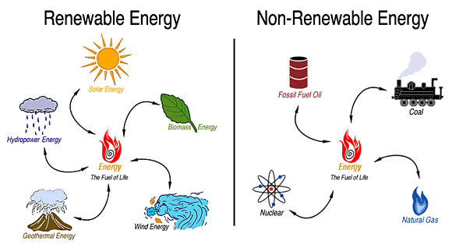
6. Conclusion

Slide 32
Figure: pie chart
Notes:
For you to have a global vision of the prediction of the energy consumption in 2035; here is a pie chart representing the US energy consumption in 2035. We can see that there is already around 70% of the US energy consumption is based on Fossil energies (coal, natural gas, oil), In 2035, the energy consumption would be based on Renewables energies for 16% (so we double the pourcentage comparing to 2012) and almost 10% based on the nuclear energy. Renewables energies are going to be developed

Slide 33
6. Conclusion
Consequences on the planet
Anthropic greenhouse gas emissions
Ecological disturbance
Pollution & Health
Means of improvement
Same access and power to generate and distribute energy
Africa and other less developing countries
Research and development of sustainable low-carbon energy

Slide 34

Thank you for your attention, Do you have any questions ?

Slide 35
Bibliography
https://www.britannica.com/topic/solar-energy
https://www.seia.org/initiatives/about-solar-energy
https://study.com/academy/lesson/what-is-solar-energy-definition-lesson-quiz.html
http://www.dictionary.com/browse/wind-power
https://www.conserve-energy-future.com/advantages_disadvantages_biomassenergy.php
https://www.e-education.psu.edu/egee102/node/1930
https://www.eia.gov/energyexplained/?page=nonrenewable_home

